Slide 1

Restaurants in Toronto
By: Alex Funches

Slide 2
Introduction
The Capital City of the province of Ontario, Toronto is the largest and most populated city in Canada.
Toronto is known as a metropolis and multicultural city
Has allowed different food cultures and practices to intertwine and be brought together in the city
Represented in ethnic neighborhoods like Chinatown, Greektown, Koreatown, Little Italy, Little India, Little Portugal, Little Jamaica etc
According to the 2016 census
Population of 2,731,571
Of which 47.5% are minorities

Slide 3
Introduction Cont.
Business Problem: Selecting the best Toronto Neighborhoods for a Restaurant
Goal: Help provide insight, reduce risk, and select a potentially more profitable, prosperous location for a restaurant in Toronto

Slide 4
Data
Toronto Neighborhood Data
Source: https://en.wikipedia.org/wiki/List_of_postal_codes_of_Canada:_M
Description: The dataset contains the borough, neighborhood, and postal code information of the city of Toronto
Geospatial Data
Source: https://cocl.us/Geospatial_data
Description: By using this we can get the geospatial data of Toronto such as the neighborhood and venue latitude and longitude coordinates to provide further information on the location
Restaurant Venues in Toronto
Source: Foursquare API
Description: Allows us to retrieve the venue types and categories in each neighborhood which we can further filter to restaurant venues

Slide 5
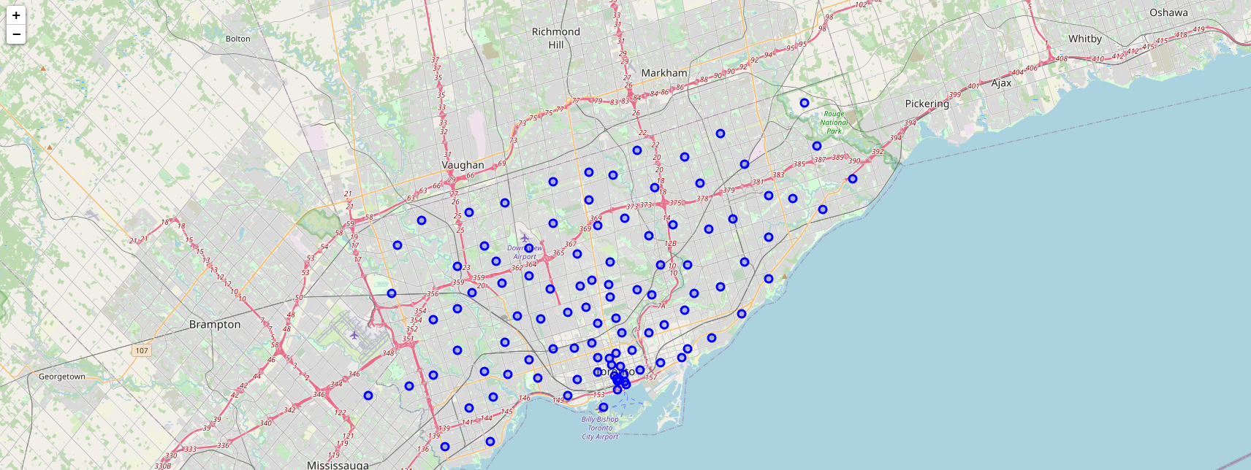
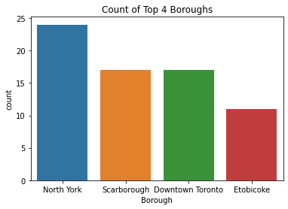
Methodology – Exploratory Data Analysis
Used BeautifulSoup to web scape and transform Toronto Neighborhood Dataset into a pandas dataframe
Includes 103 observations and 3 variables: Postal Code, Borough, and Neighborhood which are categorical
Encompasses 103 neighborhoods and 15 boroughs

Slide 6
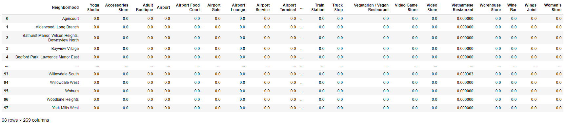
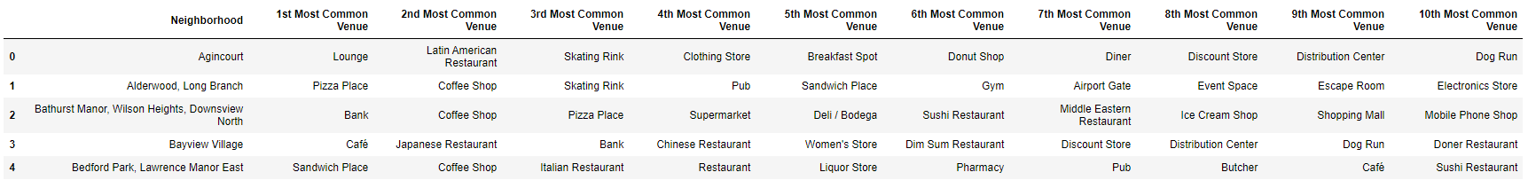
Results
Merged with Geospatial Dataset to utilize Foursquare API to find the venues in each neighborhood
Filtered Venues to Restaurants Only

Slide 7
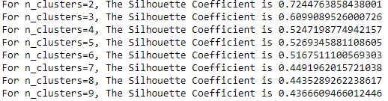
Results Cont.
Hot Encoded the data to perform K-Means Clustering
N=2 had the highest silhouette score at 0.724 so 2 clusters were chosen
Cluster 1 had the higher total and total sum at 27.4 and 54.8 indicating that it is more saturated and has less market potential for restaurants

Slide 8
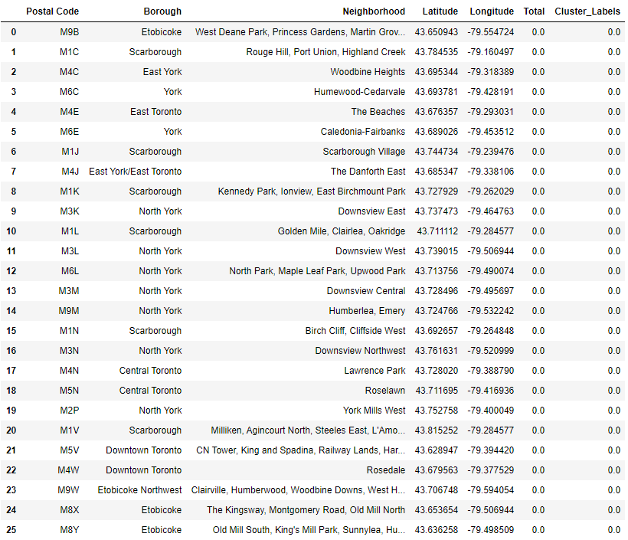
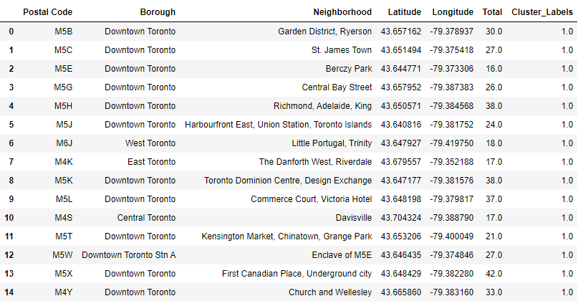
Cluster Results
Cluster0: Unsaturated Market
Cluster1: Saturated Market
*6 out of 25 observations in Cluster0 also include a Borough with Toronto in the name
*Neighborhood must be accounted for

Slide 9
Discussion
Cluster0
Has more observations at 25
Has the lower total and total sum at 3.35 and 6.7 making it less saturated
Includes Etobicoke, York, East York, Scarborough, and North York within their respective neighborhoods listed
Cluster1
Has 14 observations
Has the higher total and total sum at 27.4 and 54.8 making it more saturated
Only includes neighborhoods that have Toronto in the name
Downtown Toronto, West Toronto, East Toronto, Central Toronto

Slide 10
Conclusion
Reminder: Data is limited in size and time
The number of people in each neighborhood as well as the type and number of restaurants are always changing
Can be improved if more data is collected over time with more information like population or restaurant income
Used k-means clustering to select best neighborhoods for a restaurant
Recommend cluster0 neighborhoods and boroughs for restaurants
Areas like Etobicoke, York, East York, Scarborough, and North York and their respective neighborhoods.

